Slide 1
CI/CD: Streamlining Software Delivery
From Code to Production with Speed and Confidence

Slide 2
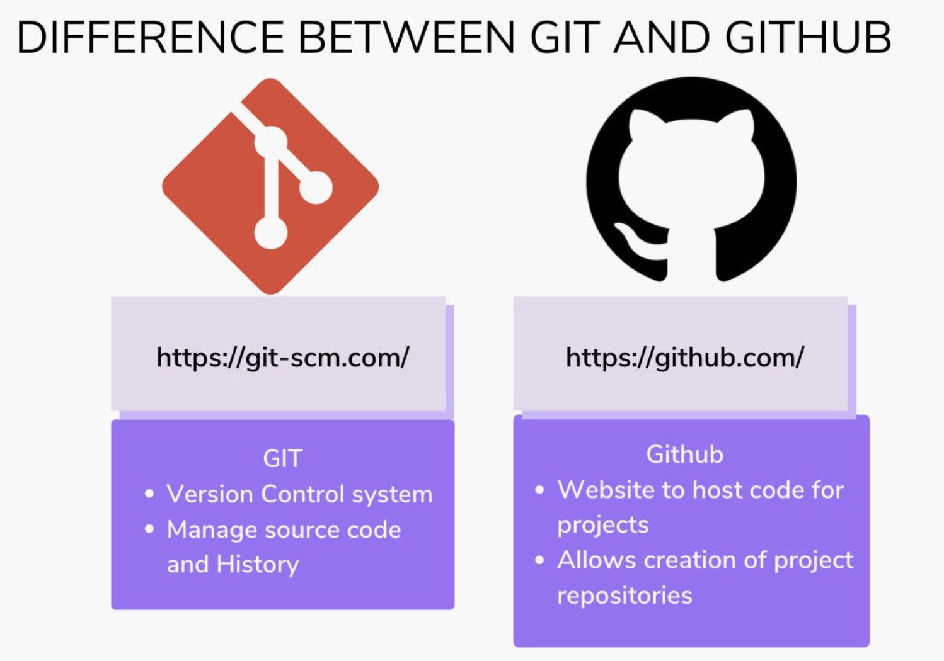

Slide 3
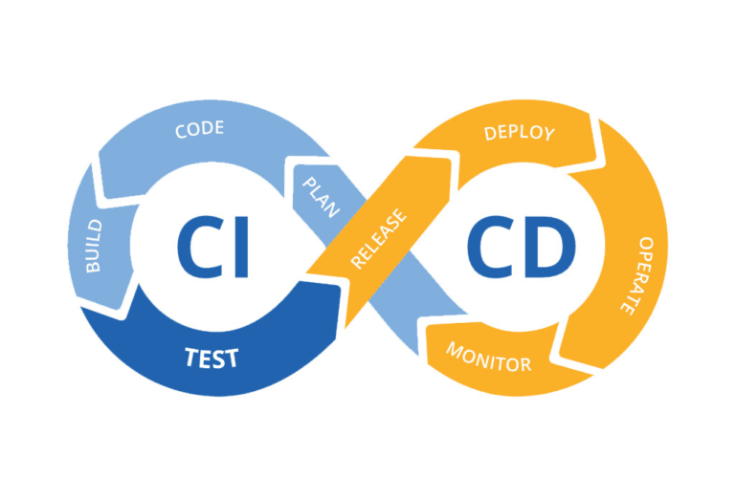
What is CI/CD? (Overview)
CI = Continuous Integration: Frequent code merges + automated testing.
CD = Continuous Delivery (auto-release to staging) or Deployment (auto-release to production).
Goal: Faster, reliable software releases.

Slide 4
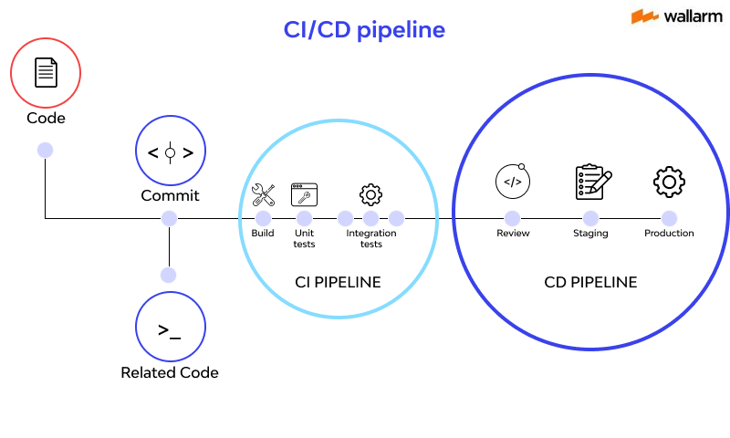

Slide 5
Continuous Integration (CI)
Developers merge code to a shared repo multiple times a day.
Automated build and test workflows catch bugs early.
Tools: Jenkins, GitLab CI, CircleCI.

Slide 6
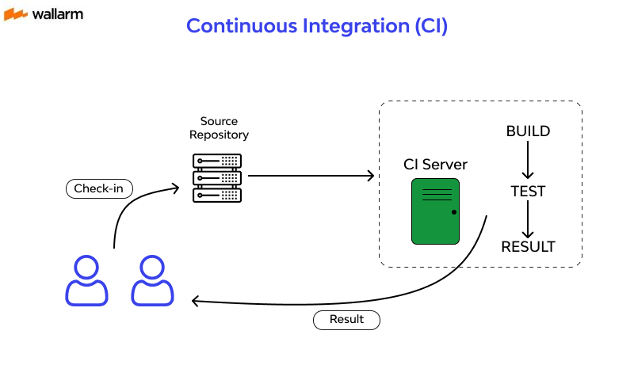

Slide 7
Continuous Delivery vs. Deployment (CD)
Delivery: Automatically deploys to staging for manual approval.
Deployment: Automatically deploys to production (no human intervention).
Example: Netflix uses CD to deploy 1,000+ times/day.

Slide 8
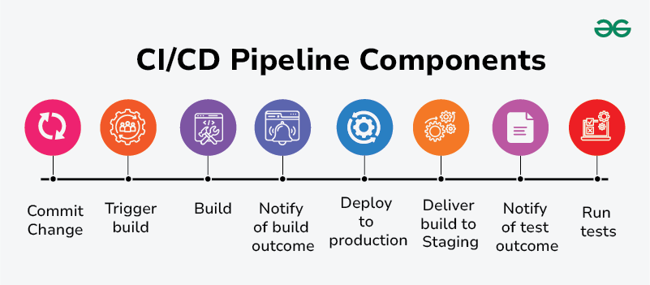
Key Components of CI/CD
Source Code Repo (e.g., GitHub).
Build Server (e.g., Jenkins).
Testing Frameworks (e.g., Selenium).
Deployment Tools (e.g., Kubernetes). Code commit → 2. Build → 3. Test → 4. Deploy to Staging → 5. Deploy to Production.

Slide 9
Benefits of CI/CD
Faster releases.
Fewer bugs in production.
Better team collaboration.
Scalability for large projects.

Slide 10
Challenges & Pitfalls
Complexity in setup.
Cultural resistance to automation.
Security risks in automated pipelines.

Slide 11
Popular CI/CD Tools
CI/CD Platforms: GitLab, GitHub Actions.
Automation: Jenkins, Travis CI.
Deployment: Docker, AWS CodeDeploy.

Slide 12
Best Practices
Automate everything.
Test in production-like environments.
Monitor pipelines for bottlenecks.

Slide 13
Future of CI/CD
AI-driven test optimization.
GitOps (infrastructure as code).
Serverless CI/CD pipelines.

Slide 14
Conclusion
CI/CD = Faster, safer, collaborative software delivery.
Start small, iterate, and invest in automation.

